Slide 1
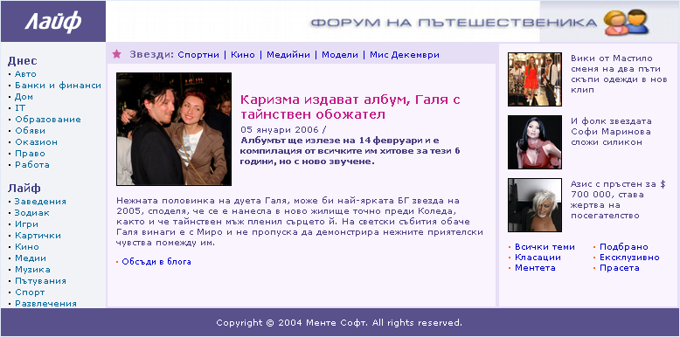
Homework
Create this with XHTML and CSS. Using tables and frames are not allowed!
See the file: site-sample.png

Slide 2

Homework (2)
Create this with XHTML and CSS. Using tables and frames is not allowed!
See the file: architecture.png

